Slide 1
COMP 4290
Week 5 - Friday

Slide 2
Last time
What did we talk about last time?
Hash functions
Birthday paradox

Slide 3
Questions?

Slide 4
Assignment 2

Slide 5
Project 2

Slide 6
Jennifer Perez Presents

Slide 7
Attacks Against Hash Functions

Slide 8
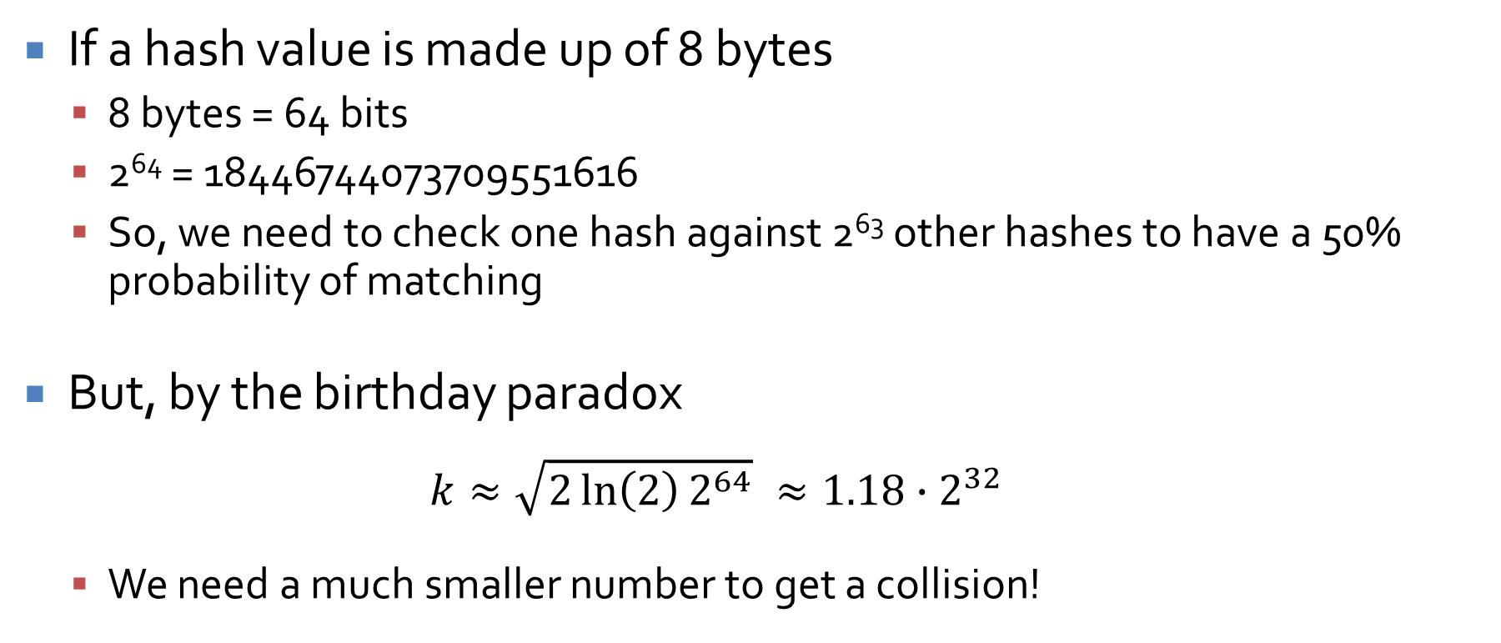
Birthday attack's revenge
If a hash value is made up of 8 bytes
8 bytes = 64 bits
2⁶⁴ = 18446744073709551616
So, we need to check one hash against 2⁶³ other hashes to have a 50% probability of matching
But, by the birthday paradox
$$k≈\sqrt{2\ln\left(2\right)2^{64}} ≈1.18∙2^{32}$$
We need a much smaller number to get a collision!

Slide 9
Theoretically awesome …
2³² operations is within the reach of modern computers in seconds, minutes, or hours
Collisions do not guarantee that the system can be hacked
A collision with an existing password is necessary
If the system has 2³² users, there's a good probability that two of them have the same password hash

Slide 10
Practical issues
Real hashes are usually longer
Salt makes things a bit more complex
Most people use weak passwords
It's easier to guess them
Social engineering
Shoulder surfing
Finding the Post-It with their password
Still, the mathematical possibilities are interesting …

Slide 11
Application: Digital Signature Attacks

Slide 12
Signing hashes
Sometimes a document needs to be digitally signed
Contracts
Commitment schemes
Hashes are often signed so that there's less data to sign and transmit
Signatures usually use public key crypto like RSA
But, if the length of the hash is not very long, we can employ the Birthday Paradox

Slide 13
Signing scheme example
Digital signature schemes typically employ public key cryptography
We need the one way property so that we can verify that it works without being able to break it
Full Domain Hash uses RSA to do this:
Given message M, we find H(M), then raise H(M) to the secret decryption exponent to find signature S
S = H(M)^{d} mod n
To verify the signature, take the signature and raise it to the publicly known encryption exponent e and compare that to the hash of the message
If S^{e} mod n = H(M), we feel reasonably sure of two things:
S is a signature for a M (M has not been changed)
Only someone who knows the private key for n could have signed it
Why does it use the hash of the message instead of the message?

Slide 14
Same rules, different game
Erica wants to buy a house from Carmen (and cheat her)
Let's say that they are going to electronically sign a 64-bit hash of the contract
Erica creates 2³² variations on a contract that Carmen will agree to
Erica creates 2³² variations on a contract which is highly advantageous to Erica
Sound ridiculous?

Slide 15
2¹⁶ contracts without trying
I, Erica, {hereby, through this document}, {agree, consent} to {purchase, buy} the {property, estate} {located, which can be found} at 742 Evergreen Terrace.
A {fair, equitable} {sale, asking} price for this {property, estate} is the {sum, amount} of $500,000. This {document, contract} states that this {sum, amount} is {to be paid, payable} on September 19, 2025 by Erica to Carmen in {exchange, return} for {ownership, possession} of the {aforementioned, aforesaid} {property, estate}.

Slide 16
Erica 1, Carmen 0
Having generated the good and bad contracts, Erica can find a good and bad pair with matching hashes with high probability
Erica sends the good one to Carmen to sign
Erica keeps the bad one, brings it to court when Carmen says that Erica didn't pay the right amount

Slide 17
The lesson?
Use hash functions with a long digest
A hash function with an m-bit digest can produce about 2^{m} different hashes
But some attacks only need around 2^{m/2} different messages to find a collision
Don't do real estate deals with Erica

Slide 18
Week 1 Review

Slide 19
The basics of computer security
Confidentiality
Integrity
Availability

Slide 20
Confidentiality
You don’t want other people to be able to read your stuff
Some of your stuff, anyway
Cryptography, the art of encoding information so that it is only readable by those knowing a secret (key or password), is a principle tool used here
Confidentiality is also called secrecy or privacy

Slide 21
Integrity
You don’t want people to mess up your stuff
You want to know:
That your important data cannot be easily changed
That outside data you consider trustworthy cannot be easily changed either
There are many different ways that data can be messed up, and every application has different priorities

Slide 22
Availability
You want to be able to use your stuff
Many attacks are based on denial of service, simply stopping a system from functioning correctly
Availability can mean any of the following:
The service is present in usable form
There is enough capacity for authorized users
The service is making reasonable progress
The service completes in an acceptable period of time

Slide 23
Harm
Malicious, human-caused threats often involve one or more of the following kind of harm:
Interception
Someone read something they weren't supposed to
Interruption
Something became unavailable or unusable
Modification
Someone changed something they weren't supposed to
Fabrication
Someone created fake things

Slide 24
Method, opportunity, motive
As with traditional crime, a computer attacker must have three things:
Method
Skills and tools to perform the attack
Opportunity
Time and access to accomplish the attack
Motive
A reason to perform the attack

Slide 25
Controls
There are six common ways of controlling attacks, many of which can be used together
Prevent
Remove the vulnerability from the system
Deter
Make the attack harder to execute
Deflect
Make another target more attractive (perhaps a decoy)
Detect
Discover that the attack happened, immediately or later
Recover
Recover from the effects of the attack
Mitigate
Make the effect of the attack less severe

Slide 26
Definition of authentication
Authentication is the binding of an identity to a subject
Example: Bill Gates (external entity) is a registered user whose identity on this system is gatesw (identity of system subject)
The external identity must provide information to authenticate based on
What the entity knows (passwords)
What the entity has (security badge)
What the entity is (fingerprints or voice ID)

Slide 27
Passwords
Passwords are one of the most common forms of authentication mechanisms based on what the entity knows
The password represents authentication information that the user must know
The system keeps complementation information that can be used to check the password
Real systems generally do not store passwords in the clear but store hashes of them
Unix chooses one of 4,096 different hash functions, hashes the password into an 11-character string, and then prepends 2 characters specifying which hash function was used

Slide 28
Attacking a password system
A dictionary attack is an attack based on guessing the password from trial and error
A dictionary attack can work on the complementary information (hashes of passwords)
If this information is unavailable, a dictionary attack can directly attack the authentication functions (literally trying to log in repeatedly)
Let P be the probability that an attacker guesses the password over a certain span of time
Let G be the number of guesses that can be made per unit time
Let T be the number of time units of guessing
Let N be the number of possible passwords
Then,

Slide 29
Defending authentication functions
Backoff
Force the user to wait longer and longer between failed authentication techniques
Exponential backoff means that the first time waits 1 second before allowing a user to log in, the second waits 2 seconds, the third waits 4 seconds, etc.
Disconnection
If the connection is remote and requires significant time to connect (dialing, VPN, etc.), the system can simply break connection after a number of failed attempts
Disabling
With n failed attempts, an account is locked until an administrator resets the account
Jailing
In jailing, the user is allowed to enter a fake system that looks like the real one
In theory, jailing can be used to learn more about an attacker's goals
Attractive data (called honeypots) can be made available, tempting the attacker to spend more time on the system (until he can be caught)

Slide 30
Biometrics
Biometrics means identifying humans by their physical and biological characteristics
This technology is often seen in spy and science fiction movies
It does exist, but it's far from perfect
Like passwords, the actual biometric scans are usually not stored
Instead specific features are stored for later comparison
Biometrics pose unique privacy concerns because the information collected can reveal health conditions

Slide 31
Problems with biometrics
People assume that they are more secure than they are
Attacks:
Fingerprints can be lifted off a champagne glass
Voices can be recorded
Iris recognition can be faked with special contact lenses
Both false positives and false negatives are possible
Disabilities can prevent people from using some kinds of biometrics
It's possible to tamper with transmission from the biometric reader
Biometric characteristics can change
Identical twins sometimes pose a problem

Slide 32
Week 2 Review

Slide 33
Tokens
Tokens are physical objects you possess
Keys
Badges
Cell phones
RFIDs
Passive tokens take no action and do not change
Example: photo ID
Active tokens change or interact with surroundings
Examples: RFID or magnetic card

Slide 34
Access control
Subjects are human users or programs that are executing on their behalf
Objects are things that actions can be performed on
Files
Database fields
Directories
Hardware devices
Access modes are the different ways that access can be done: read, write, modify, delete, etc.
Access control is the process of managing the access modes that subjects can have on objects

Slide 35
Access control goals
Check every access
The user may no longer have rights to a resource
The user may have gained rights
Enforce least privilege
Least privilege means you get the bare minimum to get your job done
Verify acceptable usage
Access to an object is not enough: Some actions might be legal and others illegal

Slide 36
Access control matrix example
 | Objects
Subjects | file 1 | file 2 | process 1 | process 2
process 1 | read, write, own | read | read, write, execute, own | write
process 2 | append | read, own | read | read, write, execute, own

Slide 37
Cryptography
"Secret writing"
The art of encoding a message so that its meaning is hidden
Cryptanalysis is breaking those codes

Slide 38
Encryption and decryption
Encryption is the process of taking a message and encoding it
Decryption is the process of decoding the code back into a message
A plaintext is a message before encryption
A ciphertext is the message in encrypted form
A key is an extra piece of information used in the encryption process

Slide 39
Notation
A plaintext is M (sometimes P)
A ciphertext is C
The encryption function E(x) takes M and converts it into C
E(M) = C
The decryption function D(x) takes C and converts it into M
D(C) = M
We sometimes specify encryption and decryption functions E_{k}(x) and D_{k}(x) specific to a key k

Slide 40
Attacks
Cryptography is supposed to prevent people from reading certain messages
Thus, we measure a cryptosystem based on its resistance to an adversary or attacker
Kinds of attacks:
Ciphertext only: Attacker only has access to an encrypted message, with a goal of decrypting it
Known plaintext: Attacker has access to a plaintext and its matching ciphertext, with a goal of discovering the key
Chosen plaintext: Attacker may ask to encrypt any plaintext, with a goal of discovering the key
Others, less common

Slide 41
Terminology remix
Rather than use letters, a system popularized by Ron Rivest is to use Alice and Bob as the two parties communicating
Carl or another “C” name can be used if three people are involved
Trent is a trusted third party
Eve is used for an evil user who often eavesdrops
Mallory is used for a malicious user who is usually trying to modify messages

Slide 42
Encryption algorithms
The algorithms for encryption often rely on a secret piece of information, called a key
We can notate the use of a specific key in either of the two following ways:
C = E_{K}(M)
C = E(K, M)
In symmetric (or private key) encryption, the encryption key and the decryption key are the same
In asymmetric (or public key) encryption, the encryption key and the decryption key are different

Slide 43
Symmetric vs. asymmetric
Symmetric Encryption
Key K
Plaintext M
Encryption
Ciphertext C
Decryption
Plaintext M
Asymmetric Encryption
Encryption Key K_{E}
Decryption Key K_{D}
Plaintext M
Encryption
Ciphertext C
Decryption
Plaintext M

Slide 44
Cryptanalysis
There are two kinds of security for encryption schemes
Unconditionally secure
No matter how much time or energy an attacker has, it is impossible to determine the plaintext
Computationally secure
The cost of breaking the cipher exceeds the value of the encrypted information
The time required to break the cipher exceeds the useful lifetime of the information
We focus on computationally secure, because there is only one practical system that is unconditionally secure
"I want them to remain secret for as long as men are capable of evil" -Avi from Cryptonomicon

Slide 45
Review of Modular Arithmetic
Modulo operator takes the remainder
Two numbers are said to be congruent modulo n if they have the same remainder when divided by n
For example,
39 ≡ 3 (mod 12)
Addition, subtraction, and multiplication:
[(a mod n) + (b mod n)] mod n = (a + b) mod n
[(a mod n) – (b mod n)] mod n = (a – b) mod n
[(a mod n) x (b mod n)] mod n = (a x b) mod n

Slide 46
Divided and Conquered
We can’t actually divide
Instead, we have to find the multiplicative inverse
The multiplicative inverse of x exists if and only if x is relatively prime to n
13 ∙ 5 ≡ 65 ≡ 1 (mod 16)
So, 13 and 5 are multiplicative inverses mod 16
But, 0, 2, 4, 6, 8, 10, and 12 do not have multiplicative inverses mod 16

Slide 47
Week 3 Review

Slide 48
Definition
A shift cipher encrypts a message by shifting all of the letters down in the alphabet
Using the Latin alphabet, there are 26 (well, 25) possible shift ciphers
We can model a shift cipher by numbering the letters A, B, C, … Z as 0, 1, 2, … 25
Then, we let the key k be the shift
For a given letter x:
E_{k}(x) = (x + k) mod 26

Slide 49
Cryptanalysis of a Shift Cipher
Cryptanalysis of a shift cipher is incredibly easy
You just have to try 26 possibilities to be sure you have the right one
A shift cipher is a simplified version of a substitution cipher

Slide 50
Definition
In a transposition cipher, the letters are reordered but their values are not changed
Any transposition cipher is a permutation function of some kind

Slide 51
Substitution ciphers
Substitution ciphers cover a wide range of possible ciphers, including the shift cipher
In a substitution cipher, each element of the plaintext is substituted for some corresponding element of the ciphertext
Monoalphabetic substitution ciphers always use the same substitutions for a letter (or given sequence of letters)
Polyalphabetic substitution ciphers use different substitutions throughout the encryption process

Slide 52
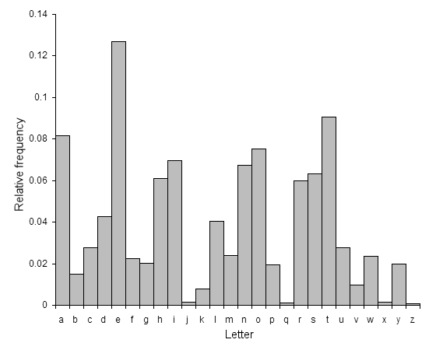
Frequency Attack
English language defeats us
Some letters are used more frequently than others:
ETAOINSHRDLU
Longer texts will behave more consistently
Make a histogram,
break the cipher

Slide 53
Vigenère cipher
The Vigenère cipher is a form of polyalphabetic substitution cipher
In this cipher, we take a key word and repeat it, over and over, until it is as long as the message
Then, we add the repetitions of keywords to our message mod 26

Slide 54
Cryptanalysis of Vigenère
The index of coincidence measures the differences in the frequencies in the ciphertext
It is the probability that two randomly chosen letters from the ciphertext are the same
IC =
Period | 1 | 2 | 3 | 4 | 5 | 10 | Large
Expected IC | 0.066 | 0.052 | 0.047 | 0.045 | 0.044 | 0.041 | 0.038

Slide 55
Normalized index of coincidence
Some systems look at a "normalized" index of coincidence, which is found by multiplying the formula given on the previous page by the number of letters in the language
26 for English
When reading the literature, both normalized and unnormalized versions can be called index of coincidence
Here are index of coincidence values for a few common languages
Language | Index
English | 1.73
French | 2.02
German | 2.05
Italian | 1.94
Portuguese | 1.94
Russian | 1.76
Spanish | 1.94

Slide 56
After the length is known…
The rest is easy
Try various shifts for each letter of the key so that high frequency letters (E, T, A) occur with high frequency and low frequency letters (Q, X, Z) occur with low frequency
Guess and check

Slide 57
Perfect secrecy
A One-Time Pad has the property of perfect secrecy or Shannon secrecy
Perfect secrecy means that P(M) = P(M|C)
Remember that it is possible to find a key that would decrypt a ciphertext to any plaintext
Thus, learning the ciphertext tells you nothing about the plaintext

Slide 58
One-Time Pad weaknesses
You can only use it one time
Otherwise, recovering the key is trivial
Completely vulnerable to known plaintext attack
The key is as long as the message
If you have a way of sending a key that long securely, why not send the message the same way?
Generating keys with appropriate levels of randomness presents a problem

Slide 59
Stream and block ciphers
A common way of dividing ciphers is into stream ciphers and block ciphers
Block ciphers divide messages into fixed length parts (or blocks) and encipher each part with the same key
Stream ciphers encipher each message character by character
Some other authors define a stream cipher to be like a block cipher except that the key changes with each block based on the message

Slide 60
Confusion and Diffusion
Confusion is the property of a cryptosystem that changing a single character in the plaintext should not have a predictable effect
Diffusion is the property of a cryptosystem that each character in the plaintext should impact many characters in the ciphertext
Examples:
Caesar cipher has poor confusion and no diffusion
One time pad has good confusion but no diffusion
Auto-key ciphers may have poor confusion but good diffusion
AES and DES have good confusion and diffusion within a block

Slide 61
DES
Data Encryption Standard
DES is a typical block cipher
It was chosen as the government's standard for encryption in 1976 (but has since been deprecated)
DES works on blocks 64 bits in size
DES uses a 56 bit key
NSA helped design it… amidst some controversy

Slide 62
DES strengths
DES is fast
Easy to implement in software or hardware
Encryption is the same as decryption
Triple DES is still standard for many financial applications
Resistant to differential and linear cryptanalysis (2⁴⁷ and 2⁴³ known pairs required, respectively)

Slide 63
DES weaknesses
Short key size
Brute force attack by EFF in 1998 in 56 hours then in 1999 in just over 22 hours
Brute force attack by University of Bochum and Kiel in 9 days in 2006 (but, using a machine costing only $10,000)
If you could check 1,000,000,000 keys per second (which is unlikely with a commodity PC), it would take an average of 417 days to recover a key

Slide 64
Double DES
"DES is wrong if you listen to NIST, Double DES ain't no better, man, that got dissed"
--MC Plus+
Double DES encrypts a plaintext with DES twice, using two different keys
Double DES is susceptible to a meet-in-the-middle attack
This attack uses a space-time tradeoff
Although two keys should mean 56 + 56 = 112 bits of security or 2¹¹² time for a brute force attack, the meet-in-the-middle attack can run in roughly 2⁵⁷ or 2⁵⁸ time, using 2⁵⁶ space

Slide 65
Double DES attack
Encrypt P₁
Decrypt C₁
Two pairs of plaintexts and ciphertexts are needed
Encrypt P₁ with all possible keys and save them
Decrypt C₁ with all possible keys
If the result matches anything in the list, use the key to encrypt P₂
If that matches C₂, you win!
On the left, I show all the decryptions, but only the encryptions need to be stored
K₁ | 492989976
K₂ | 688857766
K₃ | 282627672
K₄ | 499659602
K₅ | 532263602
K₆ | 498278096
K₇ | 752271744
K₈ | 846172716
864059530 | K₁
717075649 | K₂
993328605 | K₃
991061777 | K₄
154785500 | K₅
210537840 | K₆
688857766 | K₇
528110960 | K₈

Slide 66
Triple DES
Although susceptible to a brute force attack, DES has no other major weaknesses
Double DES can be defeated by an extension of the brute force attack
What about triple DES?
Let E_{K}(X) and D_{K}(X) be encryption and decryption using DES with key K
Triple DES uses keys K1, K2, and K3
C = E_{K1}(D_{K2}(E_{K3}(M)))
Setting K1 = K2 = K3 allows for compatibility with single DES systems
Triple DES is still a standard for financial transactions with no known practical attacks

Slide 67
Week 4 Review

Slide 68
AES
Advanced Encryption Standard
Block cipher designed to replace DES
Block size of 128-bits
Key sizes of 128, 192, and 256 bits
Like DES, has a number of rounds (10, 12, or 14 depending on key size)
Originally called Rijndael, after its Belgian inventors
Competed with 14 other algorithms over a 5 year period before being selected by NIST

Slide 69
AES pros and cons
Strengths
Strong key size
Fast in hardware and software
Rich algebraic structure
Well-studied, open standard
Weaknesses
Almost none
A few theoretical attacks exist on reduced round numbers of AES
No practical attacks other than side channel attacks

Slide 70
Public key cryptography
Sometimes, we need something different
We want a public key that anyone can use to encrypt a message to Alice
Alice has a private key that can decrypt such a message
The public key can only encrypt messages; it cannot be used to decrypt messages

Slide 71
RSA Algorithm
Named for Rivest, Shamir, and Adleman
Take a plaintext M converted to an integer
Create an ciphertext C as follows:
C = Me mod n
Decrypt C back into M as follows:
M = C^{d} mod n = (Me)^{d} mod n = M^{ed} mod n

Slide 72
The pieces
Term | Details | Source
M | Message to be encrypted | Sender
C | Encrypted message | Computed by sender
n | Modulus, n = pq | Known by everyone
p | Prime number | Known by receiver
q | Prime number | Known by receiver
e | Encryption exponent | Known by everyone
d | Decryption exponent | Computed by receiver
φ(n) | Totient of n | Known by receiver

Slide 73
How it Works
To encrypt:
C = Me mod n
e could be 3 and is often 65537, but is always publically known
To decrypt:
M = C^{d} mod n = M^{ed} mod n
We get d by finding the multiplicative inverse of e mod φ(n)
So, ed ≡ 1 (mod φ(n))

Slide 74
Why it Works
We know that ed ≡ 1 (mod φ(n))
This means that ed = kφ(n) + 1 for some nonnegative integer k
M^{ed} = M^{kφ(n) + 1} ≡ M∙(M^{φ(n)})^{k} (mod n)
By Euler’s Theorem
M^{φ(n)} ≡ 1 (mod n)
So, M∙(M^{φ(n)})^{k} ≡ M (mod n)

Slide 75
Notation for sending
We will refer to several schemes for sending data
Let X and Y be parties and Z be a message
{ Z } k means message Z encrypted with key k
Thus, our standard notation will be:
X → Y: { Z } k
Which means, X sends message Z, encrypted with key k, to Y
X and Y will be participants like Alice and Bob and k will be a clearly labeled key
A || B means concatenate message A with B

Slide 76
Kinds of keys
Typical to key exchanges is the idea of interchange keys and session keys
An interchange key is a key associated with a particular user over a (long) period of time
A session key is a key used for a particular set of communication events
Why have both kinds of keys?

Slide 77
Key exchange criteria
To be secure, a key exchange whose goal is to allow secret communication from Alice to Bob must meet this criteria:
Alice and Bob cannot transmit their key unencrypted
Alice and Bob may decide to trust a third party (Cathy or Trent)
Cryptosystems and protocols must be public, only the keys are secret

Slide 78
Classical exchange: Attempt 0
If Bob and Alice have no prior arrangements, classical cryptosystems require a trusted third party Trent
Trent and Alice share a secret key k_{Alice} and Trent and Bob share a secret key k_{Bob}
Here is the protocol:
Alice → Trent: {request session key to Bob} k_{Alice}
Trent → Alice: { k_{session} } k_{Alice} || { k_{session} } k_{Bob}
Alice → Bob: { k_{session} } k_{Bob}

Slide 79
What's the problem?
Unfortunately, this protocol is vulnerable to a replay attack
(Evil user) Eve records { k_{session} } k_{Bob} sent in step 3 and also some message enciphered with k_{session} (such as "Deposit $500 in Dan's bank account")
Eve can send the session key to Bob and then send the replayed message
Maybe Eve is in cahoots with Dan to get him paid twice
Eve may or may not know the contents of the message she is sending
The real problem is no authentication

Slide 80
Public key exchange
Suddenly, the sun comes out!
Public key exchanges should be really easy
The basic outline is:
Alice → Bob: { k_{session} } e_{Bob}
e_{Bob} is Bob's public key
Only Bob can read it, everything's perfect!
Except …
There is still no authentication

Slide 81
Easily fixable
Alice only needs to encrypt the session key with her private key
That way, Bob will be able to decrypt it with her public key when it arrives
New protocol:
Alice → Bob: {{ k_{session} } d_{Alice} }e_{Bob}
Man in the middle attacks are still possible if Alice gets the wrong public key for Bob

Slide 82
Week 5 Review

Slide 83
Catch-22
Your computer needs to be able read the password file to check passwords
But, even an administrator shouldn’t be able to read everyone’s passwords
Hash functions to the rescue!

Slide 84
Definition
A cryptographic (or one-way) hash function (called a cryptographic checksum in the book) takes a variable sized message M and produces a fixed-size hash code H(M)
Not the same as hash functions from data structures
The hash code produced is also called a digest
It can be used to provide authentication of both the integrity and the sender of a message
It allows us to store some information about a message that an attacker cannot use to recover the message

Slide 85
Crucial properties
Preimage Resistance
Given a digest, should be hard to find a message that would produce it
Collision Resistance
Should be hard to find any two messages that hash to the same digest (collision)
One-way property
Second Preimage Resistance
Given a message m, it should be hard to find a different message that has the same digest

Slide 86
Additional properties
Avalanching
A small change in input should correspond to a large change in output
Speed
It should be fast to compute a digest in software and hardware
Uniformity
Output should be a fixed length
Applicability
Hash function should work on a block of data of any size
No longer than retrieval from secondary storage

Slide 87
Salt
If you are the administrator of a large system, you might notice that two people have the same password hash
With people's password habits, the odds are very high that their passwords are the same
To add to the semantic security of such schemes extra data called salt is added to the end of a password
The salt is usually based on the time the account was created or the account name

Slide 88
MD5
Message Digest Algorithm 5
Very popular hashing algorithm
Designed by Ron Rivest (of RSA fame)
Digest size: 128 bits
Security
Completely broken
Reasonable size attacks (2³²) exist to create two messages with the same hash value
MD5 hashes are still commonly used to check to see if a download finished without error

Slide 89
SHA family
Secure Hash Algorithm
Created by NIST
SHA-0 was published in 1993, but it was replaced in 1995 by SHA-1
The difference between the two is only a single bitwise rotation, but the NSA said it was important
Digest size: 160 bits
Security
Broken if you have the resources
Theoretical attacks running in 2⁵¹ - 2⁵⁷ time exist
Google generated two PDF files with the same hash in just over 2⁶³ hashes in 2017
SHA-2 is a successor family of hash functions
224, 256, 384, 512 bit digests
Much better security
Designed by the NSA

Slide 90
Keccak (SHA-3)
Keccak uses a completely different form of hashing than SHA-0, SHA-1, and SHA-2
Although there are only theoretical attacks on SHA-1 and no real attacks on SHA-2, the attacks on SHA-0 made people nervous about hash functions following the same design
Keccak also allows for variable size digests, for added security
224, 256, 384, and 512 are standard for SHA-3, but it is possible to go arbitrarily high in Keccak

Slide 91
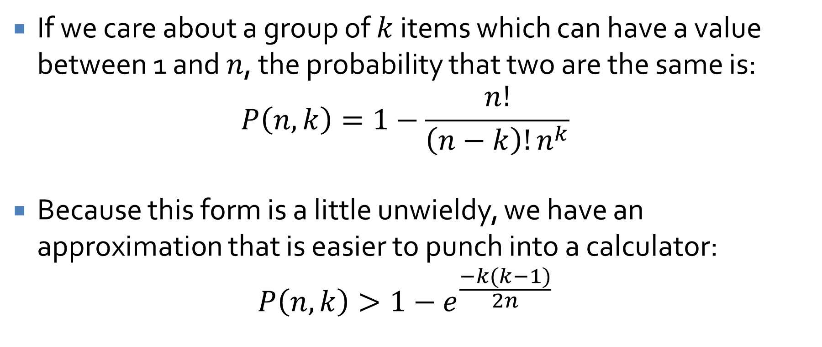
General case
If we care about a group of $k$ items which can have a value between 1 and $n$, the probability that two are the same is:
$$P\left(n,k\right)=1−\frac{n!}{\left(n−k\right)!n^{k}}$$
Because this form is a little unwieldy, we have an approximation that is easier to punch into a calculator:
$$P\left(n,k\right)>1−e^{\frac{−k(k−1)}{2n}}$$

Slide 92
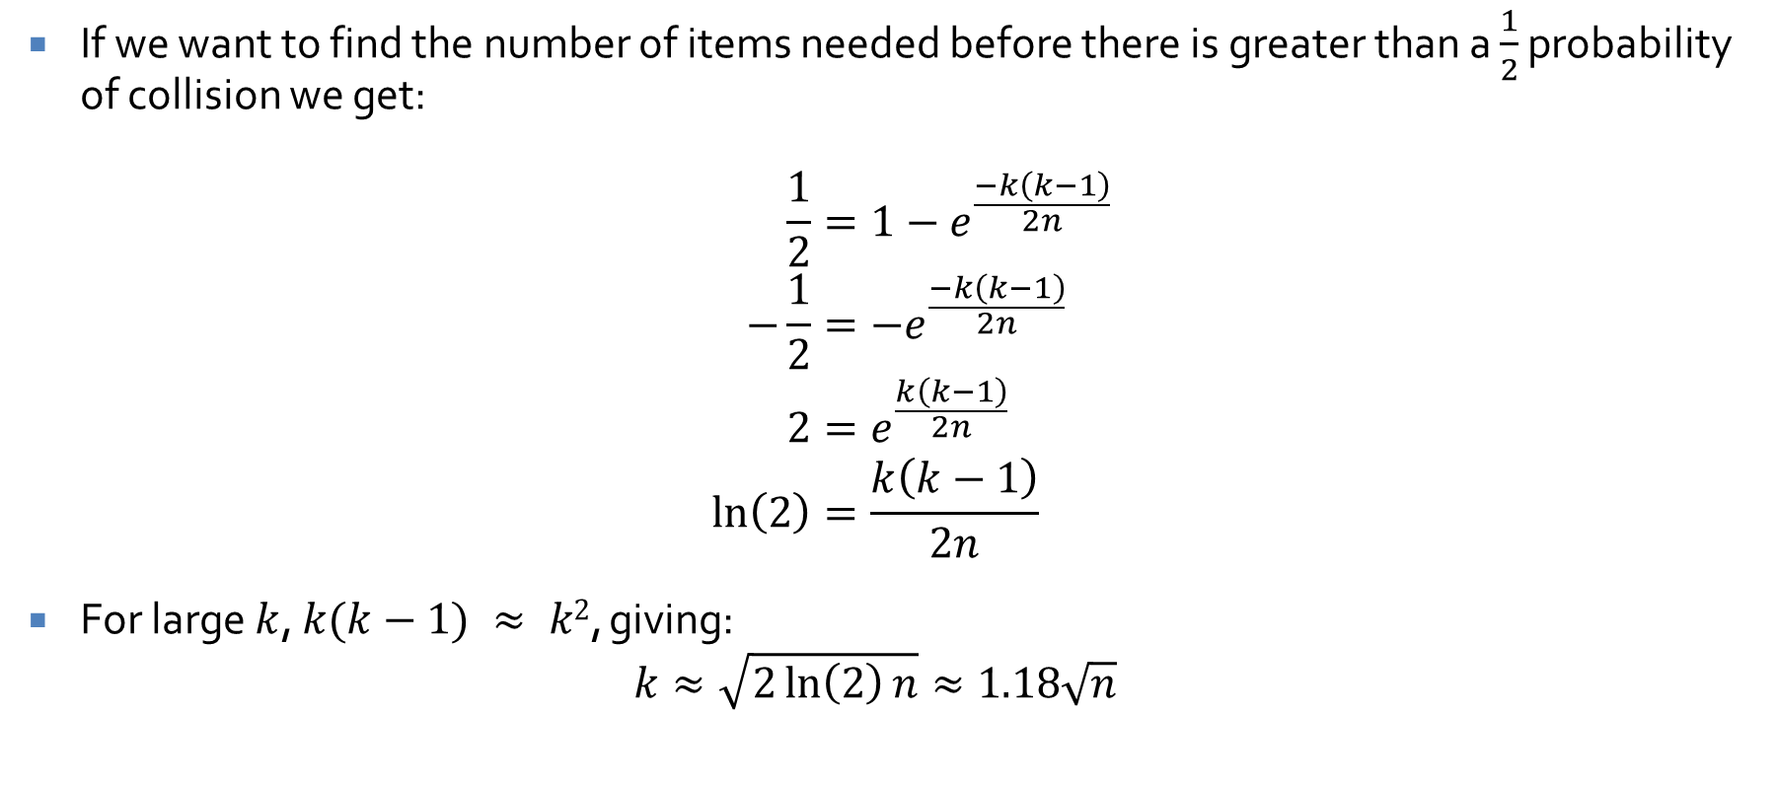
Count it up
If we want to find the number of items needed before there is greater than a $\frac{1}{2}$ probability of collision we get:
$$\frac{1}{2}=1−e^{\frac{−k\left(k−1\right)}{2n}} \\ −\frac{1}{2}=−e^{\frac{−k\left(k−1\right)}{2n}} \\ 2=e^{\frac{k\left(k−1\right)}{2n}} \\ \ln\left(2\right)=\frac{k\left(k−1\right)}{2n}$$
For large $k$, $k(k−1) ≈ k2$, giving:
$$k≈\sqrt{2\ln\left(2\right)n}≈1.18\sqrt{n}$$

Slide 93
Signing scheme example
Digital signature schemes typically employ public key cryptography
We need the one way property so that we can verify that it works without being able to break it
Full Domain Hash uses RSA to do this:
Given message M, we find H(M), then raise H(M) to the secret decryption exponent to find signature S
S = H(M)^{d} mod n
To verify the signature, take the signature and raise it to the publicly known encryption exponent e and compare that to the hash of the message
If S^{e} mod n = H(M), we feel reasonably sure of two things:
S is a signature for a M (M has not been changed)
Only someone who knows the private key for n could have signed it
Why does it use the hash of the message instead of the message?

Slide 94
The lesson?
Use hash functions with a long digest
A hash function with an m-bit digest can produce about 2^{m} different hashes
But, some attacks only need around 2^{m/2} different messages to find a collision

Slide 95
Upcoming

Slide 96
Next time…
Exam 1 on Monday

Slide 97
Reminders
Office hours from 1:45-4 p.m. canceled today
Review chapters 1, 2, and 12 for Exam 1
Finish Assignment 2
Due tonight by midnight!
Start on Project 2

